Slide 1
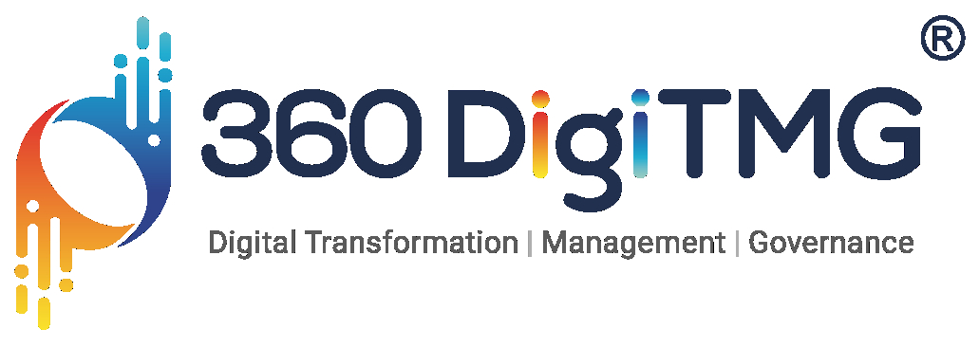

Data Analytics Project
Project Name :-
Raw Material ( Metals & Minerals) Price Forecasting AI App
By Siddhant Khapekar

Slide 2

Project Leadership
Sharat Manikonda
Director at Innodatatics and Sponsor
linkedin.com/in/sharat-chandra

Slide 3
Contents
Business objective
Business Constraints
Project Architecture
Data collection and details
Exploratory Data Analysis
Visualization
Notes:
Change

Slide 4
Business Problem
Business Problem :-
The business problem at hand is the unpredictable fluctuation in the prices of raw materials
(Metals & Minerals), negatively impacting the cost structure and inventory management.
Business Objective :-
Minimize procurement costs, maximize profitability, and enhance competitiveness through efficient management of raw material (metals & minerals) sourcing and pricing strategies within the global market for mission-critical engineered solutions.
Business Constraint :-
Minimize the impact of price volatility on production costs and optimize procurement strategies to ensure stable and affordable sourcing of raw materials (Metals & Minerals) for its engineered solutions.

Slide 5
Project Overview and Scope
Milestone | Deliverable
Identifying Constraints and design the project architecture, explore various public forums to collect relevant data, Data Preparation. | Deliverable 1.1—Identifying Constraints and design the project architecture. Deliverable 1.2—Explore various public forums to collect relevant data. Deliverable 1.3— Data Preparation
EDA and Descriptive Analytics EDA & Pre-Processing in python & SQL | Deliverable 2.1— EDA and Descriptive Analytics Deliverable 2.2— Insights documentation Deliverable 2.3 --- EDA & Pre-Processing in python & SQL
Show case and review, Final Presentation and documentation, Handover and KT. | Deliverable3.1 – show case and review. Deliverable3.2 – Final Presentation and documentation Deliverable3.3 – Handover and KT

Slide 6
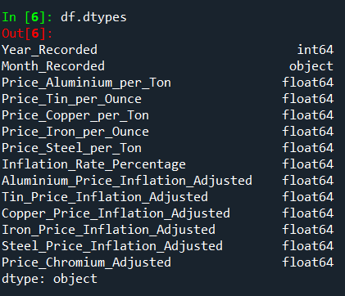
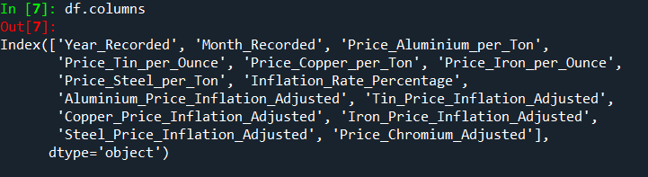
Data Dictionary
In this project we used Metal & Minerals dataset for EDA & Pre-processing and columns on which EDA & Pre-processing takes place are:-

Slide 7
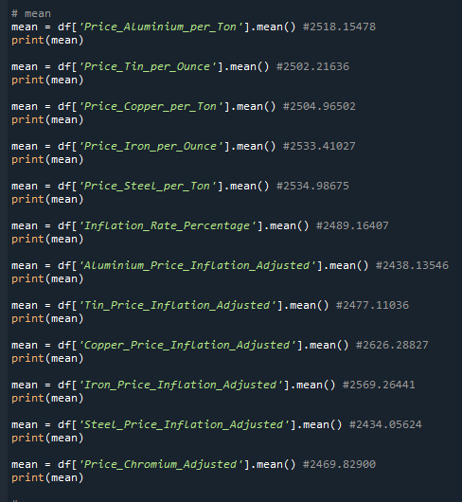
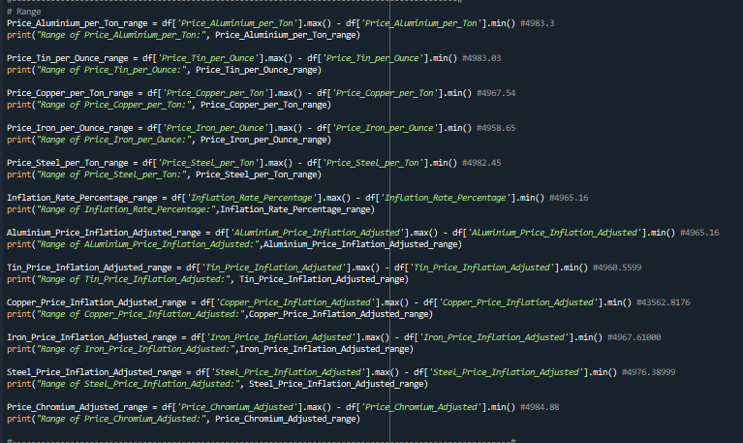
Exploratory Data Analysis [EDA]
In exploratory data analysis (EDA), various statistical measures are utilized to understand the characteristics of a dataset. Here are definitions of mean, median, mode, variance, standard deviation, range, skewness, and kurtosis in the context of EDA:
Mean: The mean, often referred to as the average, is calculated by summing up all the values in a dataset and dividing by the total number of values. It represents the central tendency of the data.
Range: The range is the difference between the maximum and minimum values in a dataset. It provides a simple measure of the spread of the data but is sensitive to outliers.
Notes:
EDA is used for seeing what the data can tell us before the modeling task.
Change

Slide 8
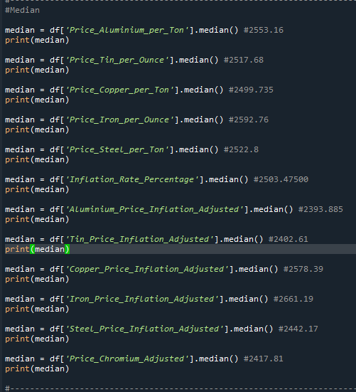
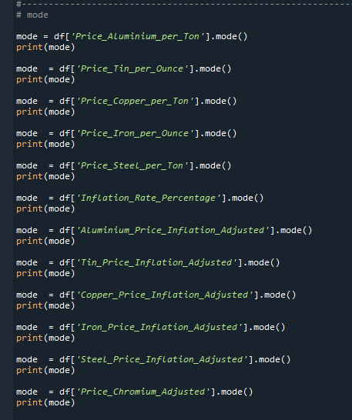
Median: The median is the middle value of a dataset when it is ordered from smallest to largest. If there is an even number of observations, the median is the average of the two middle values. It is a measure of central tendency that is robust to outliers.
Mode: The mode is the value that appears most frequently in a dataset. A dataset can have multiple modes if more than one value occurs with the same highest frequency. Modes are particularly useful for categorical data or discrete numerical data.

Slide 9
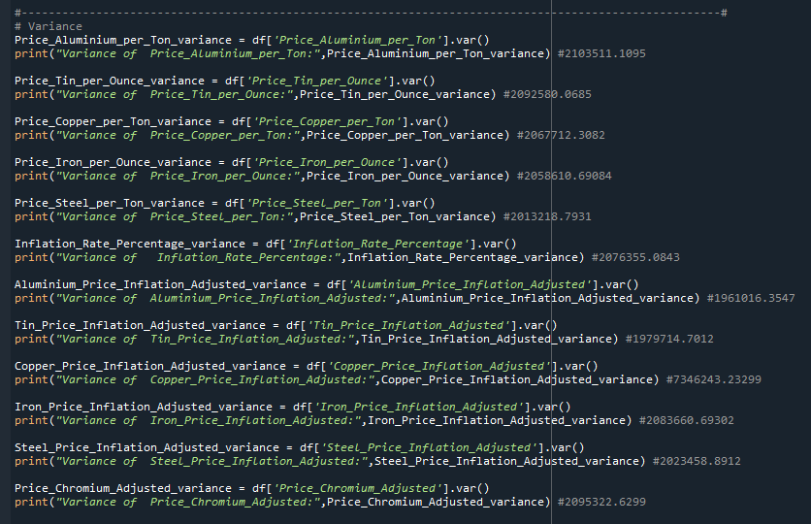
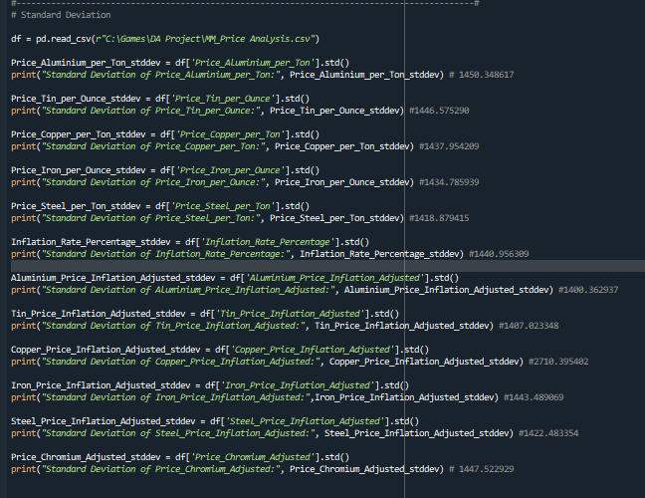
Variance: Variance measures the spread or dispersion of a set of values around the mean. It is calculated by averaging the squared differences between each value and the mean. A higher variance indicates greater variability in the dataset.
Standard Deviation: The standard deviation is the square root of the variance and is expressed in the same units as the original data. It provides a measure of the average distance of data points from the mean. A higher standard deviation indicates greater variability in the dataset.

Slide 10
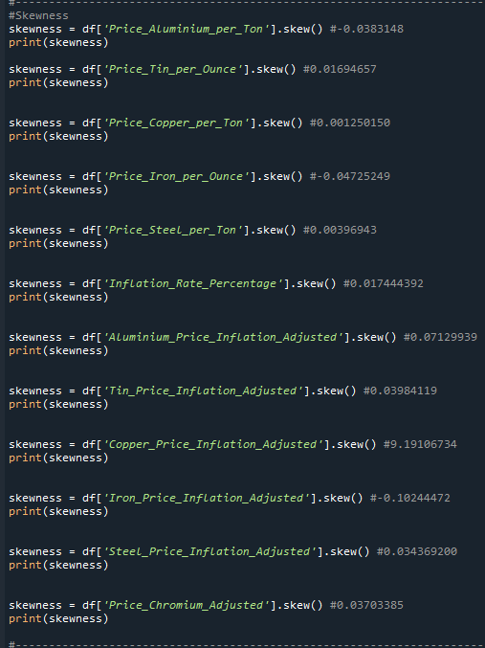
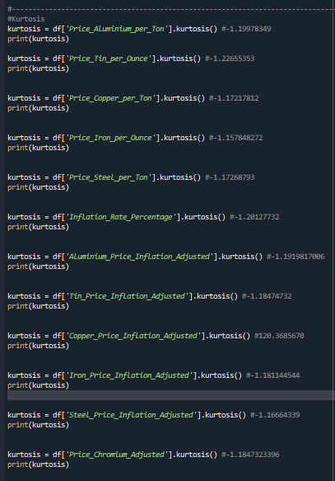
Skewness: Skewness measures the asymmetry of the distribution of data around its mean. A positive skew indicates that the right tail of the distribution is longer or fatter than the left tail, while a negative skew indicates the opposite. A skewness of zero indicates a symmetrical distribution.
Kurtosis: Kurtosis measures the peakedness or flatness of the distribution of data relative to a normal distribution. Positive kurtosis indicates a sharper peak and heavier tails compared to a normal distribution (leptokurtic), while negative kurtosis indicates a flatter peak and lighter tails (platykurtic). A kurtosis of zero indicates a normal distribution.

Slide 11
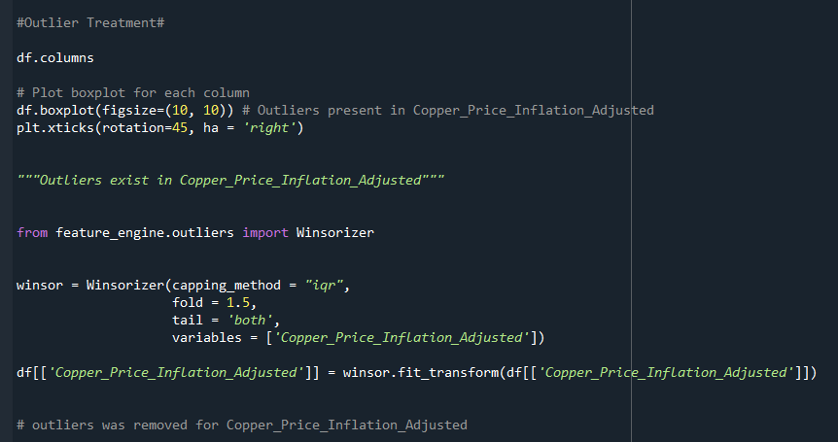
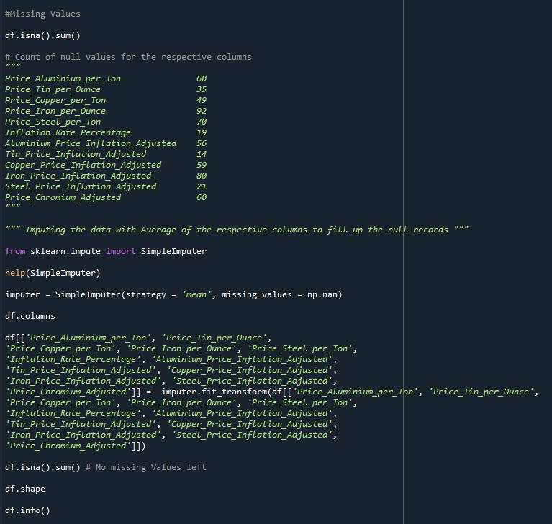
Data Preprocessing
In this project we did data pre-processing in both Python and SQL, the main data pre-processing technique used in project are:-
Outlier Treatment:-
Outlier treatment in Exploratory Data Analysis (EDA) involves identifying and handling data points that deviate significantly from the rest of the data. One common method for identifying outliers is the Z-score method, where a threshold value is chosen and data points with Z-scores above the threshold are considered outliers.
Missing Values :-
In the context of Exploratory Data Analysis (EDA) in Python, missing values are typically represented as NaN (Not a Number) values in a pandas dataFrame.
Notes:
Keep observations

Slide 12
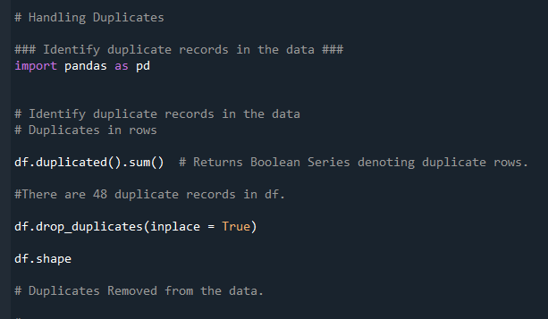
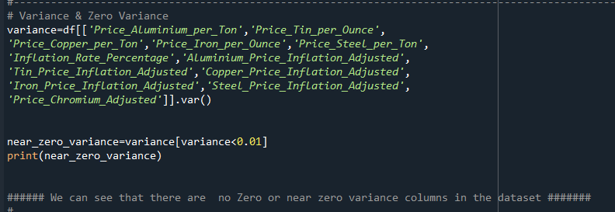
Handeling Duplicates :-
Handling duplicates in exploratory data analysis in Python typically involves identifying and dealing with duplicate observations in a dataset. Duplicate observations can be a problem in Machine Learning because they can cause your model to over-bias to observations that aren't part of the real dataset.
Variance & Zero variance :-
Variance in Exploratory Data Analysis (EDA) is a measure of the spread of a dataset, which indicates how much the individual data points deviate from the mean value. In other words, it measures the dispersion of a set of data points.
Zero variance, on the other hand, is a situation where all the values of a feature or variable are the same, and there is no variation in the dataset. This can occur if the data is constant or if the data has been incorrectly measured or recorded.

Slide 13
Data Visualization
Data Visualization is a process of creating meaningful insight from the data so that data is understandable to client . In this project we used power BI or Tableau and google looker for visualization of data :-
Power BI:-
Power BI is a business analytics tool developed by Microsoft that allows users to analyze and visualize data from various sources. It is designed to provide interactive visualizations and business intelligence capabilities to enable users to make informed decisions.
Power BI allows users to connect to multiple data sources, including Excel, SQL Server, Oracle, and other databases, cloud services, and files. Once connected, users can clean, transform, and model the data to prepare it for analysis.
Power BI provides a range of visualization options, including charts, graphs, maps, and tables, that allow users to present data in an easy-to-understand and engaging way. Users can also create custom visualizations using templates or third-party plugins.
Tableau:-
Tableau is a data visualization and business intelligence software that enables users to create interactive dashboards and reports. It is a powerful tool for data analysis and allows users to connect to various data sources, such as spreadsheets, databases, and cloud services.
Tableau provides a drag-and-drop interface for creating visualizations, which makes it easy to use even for non-technical users. It also supports advanced analytics, such as statistical modeling, predictive analytics, and data mining.
Tableau allows users to create interactive dashboards that can be shared with others, both inside and outside the organization. It also supports real-time data analysis, enabling users to quickly identify trends and insights.
Google Looker:-
Looker is a business intelligence software company that offers a data exploration and discovery platform. It was acquired by Google in 2019 and is now a part of the Google Cloud Platform. Looker's platform allows users to define relationships in their database using a simple modeling language called LookML, which enables business users to explore, save, and download data with only a basic understanding of SQL.
Looker's platform offers a variety of tools for relational database work, business intelligence, and other related services. It is widely used by organizations to analyze and visualize data, identify trends and insights, and make informed decisions.
Notes:
Add graphical

Slide 14


